Slide 1
CLASS 6

Slide 2
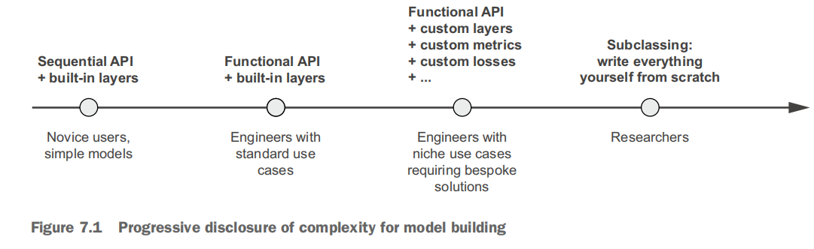
Keras Model Building
1. Sequential
2. Functional API
3. Model Sub-Classing

Slide 3
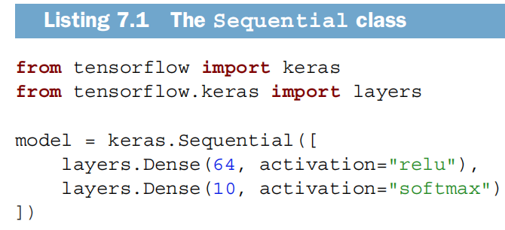
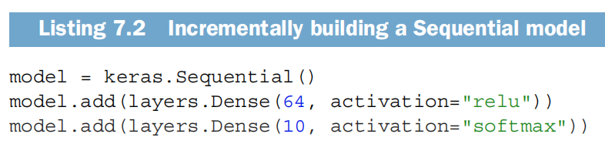
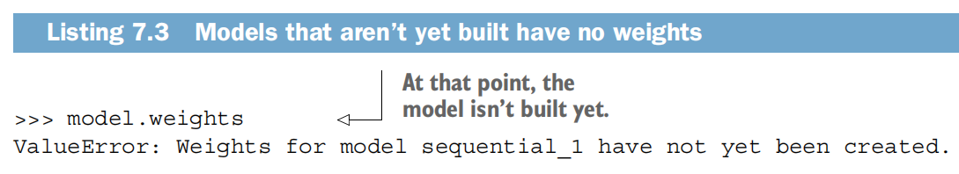
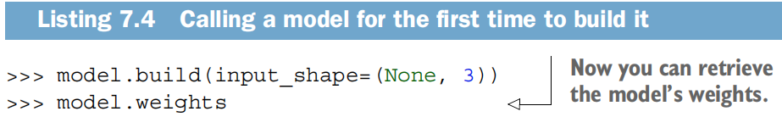
Sequential Layer

Slide 4
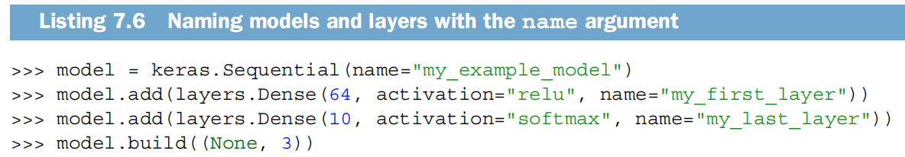
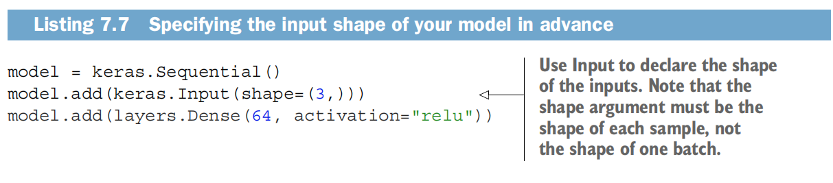
Sequential Layers

Slide 5
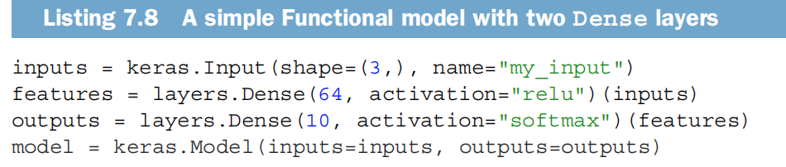
Functional API
More powerful and most MLE use this layer.
These objects are called Symbolic tensors. No data, but will hold data when model is executed.
i.e.
we can use ‘features.shape’, ‘features.type’ over these objects

Slide 6
Multi-input, Multi Output Models
Go to Book

Slide 7
Call backs
A callback is an object (a class instance implementing specific methods) that is passed to the model in the call to fit()
It has access to all the available data about the state of the model and its performance.
and it can take action: interrupt training, save a model, load a different weight set, or otherwise alter the state of the model.
The keras.callbacks module includes a number of built-in callbacks (this is not an
exhaustive list):
model.fit(train_data, train_labels, epochs=20, validation=(valid_data, valid_labels), callbacks=[EarlyStopping, LearningRateScheduler,....])

Slide 8
Callbacks Example Use Cases
Model checkpointing—Saving the current state of the model at different points during training.
Early stopping—Interrupting training when the validation loss is no longer improving (and of course, saving the best model obtained during training).
Dynamically adjusting the value of certain parameters during training—Such as the learning rate of the optimizer.
Logging training and validation metrics during training, or visualizing the representations learned by the model as they’re updated.

Slide 9
Keras Popular Callback APIs
keras.callbacks.ModelCheckpoint
keras.callbacks.EarlyStopping
keras.callbacks.LearningRateScheduler
keras.callbacks.ReduceLROnPlateau
keras.callbacks.CSVLogger
Examples in vs code

Slide 10
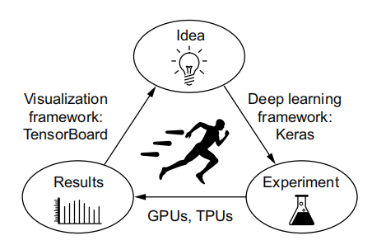
Tensorboard Usage
With TensorBoard, you can
○ Visually monitor metrics during training
○ Visualize your model architecture
○ Visualize histograms of activations and gradients
○ Explore embeddings in 3D
Easy Steps to User Callback
Install on the machine: pip install tensorboard
Run follwoing coomand on python prompt:
tensorboard --logdir /’tb_log_dir’ # or any name
Include callback in model.fit(): model.fit(train_images, train_labels,
epochs=10,
validation_data=(val_images, val_labels),
callbacks=[tensorboard]
)

